Slide 1
P2 - Physics
Speed, Distance and Time & Velocity, Acceleration and Time

Slide 2
P2 – Physics - Aims
to construct distance-time graphs for a body (object) moving in a straight line, when the body (object) is stationary or when the body (object) is moving with a constant speed
to construct velocity-time graphs for a body (object) moving with a constant velocity, or a constant acceleration

Slide 3
P2 – Physics – Aims (Higher Tier)
to calculate the speed of a body (object) from the slope of a distance-time graph
to calculate the acceleration of a body (object) from the slope of a velocity-time graph
to calculate the distance travelled by a body from a velocity-time graph

Slide 4
Speed, Distance, and Time
Speed = distance (in metres)
time (in seconds)
D
×
S
T
Try These
Paul walks 200 metres in 40 seconds. What is his speed?
Siân covers 2km in 1,000 seconds. What is her speed?
How long would it take Mike to run 100 metres if he runs at 10m/s?
Adam travels at 50m/s for 20s. How far does he go?
Hannah drives her car at 85mph (about 40m/s). How long does it take her to drive 20km?

Slide 5
Speed, Distance and Time
Key Points
The slope of a distance-time graph represents speed
“Silly Dog Tricks” (SDT)

Slide 6
Distance-time graphs
40
30
20
10
0
2) Horizontal line = Stationary
4) Diagonal line downwards = Speed
Distance
(metres)
20 40 60 80 100
Time/s
Diagonal line = Speed
3) Steeper diagonal line = Speed (Faster than in 1) as the gradient is steeper

Slide 7
Distance-time graphs
40
30
20
10
0
Distance
(metres)
Time/s
Try These
20 40 60 80 100
What is the speed during the first 20 seconds?
How far is the object from the start after 60 seconds?
What is the speed during the last 40 seconds?
When was the object travelling the fastest?

Slide 8
Speed vs. Velocity
Speed is simply how fast you are travelling…
This car is travelling at a speed of 20m/s
Velocity is “speed in a given direction”…
This car is travelling at a velocity of 20m/s east

Slide 9
Acceleration, Velocity and Time
V
Acceleration = change in velocity (m/s)
(m/s²) time taken (seconds)
×
A
T
Try These
A cyclist (Lucy) accelerates from 0 to 10m/s in 5 seconds. What is her acceleration?
A ball (Dom) is dropped and accelerates downwards at a rate of 10m/s² for 12 seconds. How much will the ball’s velocity increase by?
A car (Vicci) accelerates from 10 to 20m/s with an acceleration of 2m/s². How long did this take?
A rocket (Dinnage) accelerates from 1,000m/s to 5,000m/s in 2 seconds. What is its’ acceleration?

Slide 10
Acceleration, Velocity and Time
Key Points
The Velocity of a body (object) is its speed in a given direction
The slope of a velocity-time graph represents acceleration
The area under a velocity-time graph represents distance travelled
“VAT”!!

Slide 11
Velocity-time graphs
1) Upwards line = acceleration
80
60
40
20
0
4) Downward line = deceleration
Velocity
m/s
10 20 30 40 50
Time (s)
2) Horizontal line = no acceleration
3) Upwards line = acceleration

Slide 12
Velocity-time graphs
80
60
40
20
0
Velocity
m/s
Try These
10 20 30 40 50
Time (s)
How fast was the object going after 10 seconds?
What is the acceleration from 20 to 30 seconds?
What was the deceleration from 30 to 50s?
How far did the object travel altogether?

Slide 13
P2 - Physics
Forces

Slide 14
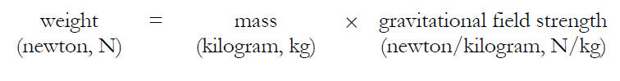
P2 – Physics - Aims
To draw and interpret velocity-time graphs for bodies that reach terminal velocity, including a consideration of the forces acting on the body
To calculate the weight of a body using:

Slide 15
Terminal Velocity
KEY POINTS
The faster a body moves through a fluid the greater the frictional force which acts on it
A body (object) falling through a fluid will initially accelerate due to the force of gravity. Eventually the resultant force on the body (object) will be zero and it will fall at its terminal velocity.

Slide 16
Terminal Velocity
Consider a skydiver:
At the start of his jump the air resistance is _______ so he _______ downwards.
2) As his speed increases his air resistance will _______
3) Eventually the air resistance will be big enough to _______ the skydiver’s weight. At this point the forces are balanced so his speed becomes ________ - this is called TERMINAL VELOCITY
Words – increase, small, constant, balance, accelerates

Slide 17
Terminal Velocity
Consider a skydiver:
4) When he opens his parachute the air resistance suddenly ________, causing him to start _____ ____.
5) Because he is slowing down his air resistance will _______ again until it balances his _________. The skydiver has now reached a new, lower ________ _______.
Words – slowing down, decrease, increases, terminal velocity, weight

Slide 18
Velocity-time graph for terminal velocity…
Parachute opens – diver slows down
Speed increases
Terminal velocity reached…
Velocity
On the Moon
Time
New, lower terminal velocity reached
Diver hits the ground

Slide 19
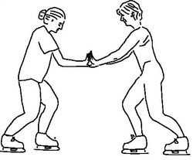
Forces
Whenever two bodies (objects) interact, the forces they exert on each other are equal and opposite
A number of forces acting on a body may be replaced by a single force which has the same effect on the body (object) as the original forces all acting together. The force is called the resultant force

Slide 20
Forces
If the resultant force acting on a stationary body (object) is zero the body (object) will remain stationary

Slide 21
Forces
If the resultant force acting on a stationary body (object) is not zero the body (object) will accelerate in the direction of the resultant force.
OR

Slide 22
Forces
If the resultant force acting on a moving body (object) is zero the body (object) will continue to move at the same speed and in the same direction

Slide 23
Forces
If the resultant force acting on a moving body (object) is not zero the body (object) will accelerate in the direction of the resultant force

Slide 24
Forces
When a vehicle travels at a steady speed the frictional forces balance the driving force
The greater the speed of a vehicle the greater the breaking force needed to stop it in a certain direction

Slide 25
Force, Mass and Acceleration
Force is measured in Newtons (N)
Mass is measured in Kilograms (Kg)
Acceleration is measured in metre/second² (m/s²)
If the forces acting on an object are unbalanced then the object will accelerate
F
×
M
A

Slide 26
Force, Mass and Acceleration
Try These
F
A force of 1000N is applied to push a mass of 500kg. How quickly does it accelerate?
A force of 3000N acts on a car to make it accelerate by 1.5m/s². How heavy is the car?
A car accelerates at a rate of 5m/s². If it weighs 500kg how much driving force is the engine applying?
A force of 10N is applied by a boy while lifting a 20kg mass. How much does it accelerate by?
×
M
A

Slide 27
Stopping a car…
Tiredness
Too much alcohol
Thinking distance
(reaction time)
Too many drugs
Poor visibility
Wet roads
Icy roads
Braking distance
Tyres/brakes worn out
Driving too fast

Slide 28
Stopping a car...
The stopping distance of a vehicle depends on the distance the vehicle travels during the driver’s reaction time and the stopping distance it travels under the braking force.
A driver’s reaction time can be affected by tiredness, drugs and alcohol
A vehicle’s braking distance can be affected by adverse road and weather conditions and poor condition of the vehicle

Slide 29
P2 - Physics
Movement

Slide 30
P2 – Physics - Aims
to discuss the transformation of kinetic energy to other forms of energy in particular situations

Slide 31
Movement
When a body speeds up or slows down, its kinetic energy increases or decreases
The forces which cause the change in speed do so by transferring energy to, or from, the body (object)
When a force causes a body (object) to move through a distance, energy is transferred and work is done
Work Done = Energy Transferred

Slide 32
Work Done, Force & Distance
The amount of work done, force and distance are related by the equation:
Work Done (joules, J)
Force (newtons, N)
Distance (metres, m)
Moved in direction of force!
Work done against frictional forces is mainly transferred into heat
W
×
D
F

Slide 33
Work Done, Force & Distance
Lucy pushes a book 5m along the table with a force of 5N. She gets tired and decides to call it a day. How much work did she do?
Vicci lifts a laptop 2m into the air with a force of 10N. How much work does she do?
Kern does 200J of work by pushing a wheelbarrow with a force of 50N. How far did he push it?
Chris cuddles his cat and lifts it 1.5m in the air. If he did 75J of work how much force did he use?
Raymond drives his car 1000m. If the engine was producing a driving force of 2000N how much work did the car do?

Slide 34
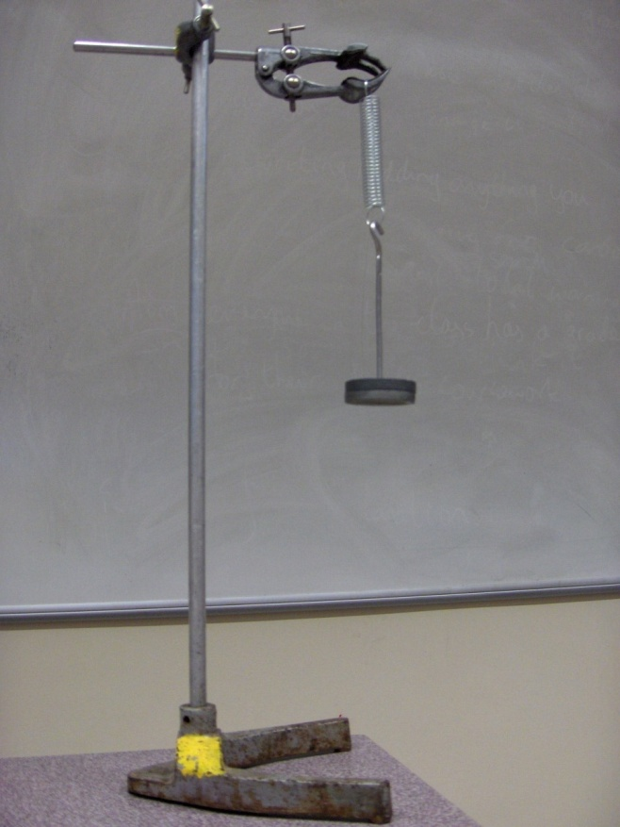
Elastic Potential Energy
For an object that is able to recover its original shape, elastic potential is the energy stored in the object when work is done on the object to change its shape

Slide 35
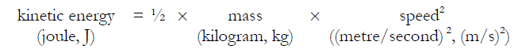
Kinetic Energy
The kinetic energy of a body (object) depends on its mass and speed
You can calculate the kinetic energy of a body using the equation:

Slide 36
Kinetic Energy
Siân drives her car at a speed of 30m/s. If the combined mass of her and the car is 1000kg what is her kinetic energy?
Kim rides her bike at a speed of 10m/s. If the combined mass of Kim and her bike is 80kg what is her kinetic energy?
Tommy is running and has a kinetic energy of 750J. If his mass is 60kg how fast is he running?
Katherine is walking to town. If she has a kinetic energy of 150J and she’s walking at a pace of 2m/s what is her mass?

Slide 37
P2 - Physics
Momentum

Slide 38
P2 – Physics - Aims
to use the conservation of momentum to calculate the mass, velocity or momentum of a body (object) involved in a collision or explosion
to use the ideas of momentum to explain safety features

Slide 39
Momentum
The faster a body (object) is moving the more kinetic energy it has. It also has MOMENTUM
When working out what happens to bodies (objects) as a result of explosions or collisions it is more useful to think in terms of momentum than in terms of energy
Momentum has both magnitude and direction
When a force acts on a body that is moving, or able to move, a change in momentum occurs

Slide 40
Momentum, Mass & Velocity
Momentum, mass and velocity are related by the equation:
Momentum (P) (Kg m/s)
Kilogram metre/second
Mass (Kg)
Kilogram
Velocity (m/s)
Metre/second
P
×
V
M

Slide 41
Momentum
What is the momentum of the following?
A 1kg football travelling at 10m/s
A 1000kg Mini Cooper S travelling at 30m/s
A 20g pen being thrown across the room at 5m/s
A 70kg bungee-jumper falling at 40m/s

Slide 42
Conservation of Momentum
So long as no external forces are acting on the objects involved, the total momentum stays the same in explosions and collisions
We say that momentum is conserved
You can use this idea to work out the mass, velocity or momentum of an object in an explosion or collision

Slide 43
Conservation of Momentum - Example
QUESTION
A bullet with a mass of 0.03 kg leaves a gun at 1000m/s. If the gun’s mass is 1.5kg, what is the velocity of the recoil of the gun
ANSWER
First work out the Momentum of the bullet
0.03 x 1000 = 30 kg m/s
Then, velocity of recoil on gun will be
Velocity = Momentum/Mass
30kg m/s / 1.5kg = 20m/s

Slide 44
Conservation of Momentum
In the below question two cars collide together; the grey sports car collides into the back of the greenish family car and sticks to it. Work out their speed after the collision.
Speed = 50m/s
Speed = 20m/s
Mass = 1000kg
Mass = 800kg
Mass = 1800kg
Speed = ??m/s

Slide 45
Conservation of Momentum
Answer
Work out the TOTAL MOMENTUM before the collision
(1000kg x 50m/s) + (800Kg x 20m/s)
50000kg m/s + 16000kg m/s = 66000kg m/s
Then to find the velocity of the cars after the collision
Velocity = Momentum/Mass
*The Mass of the cars after the collision was the same as before the collision = 1800kg*
So, 66000kg m/s/1800kg = 36.7m/s

Slide 46
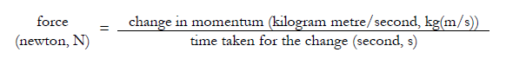
Force, Change in Momentum & Time
Force, change in momentum and time taken for the change are related by the equation:
A 25 kg bicycle is travelling at 12 m/s. What force is needed to bring it to a halt in 5 s?
First work out the change in momentum, then divide it by the time taken! So, 300kg m/s / 5s = 60N

Slide 47
P2 - Physics
Static Electricity

Slide 48
P2 – Physics - Aims
to explain why static electricity is dangerous in some situations and how precautions can be taken to ensure that the electrostatic charge is discharged safely
to explain how static electricity can be useful

Slide 49
P2 – Physics – Static Electricity
Static electricity can be explained in terms of electrical charges. When electrical charges move we get an electric current
When certain insulating materials are rubbed against each other they become electrically charged
Negatively charged electrons are rubbed off one material onto the other
The material that gains electrons becomes negatively charged
The material that loses electrons is left with an equal positive charged

Slide 50
P2 – Physics – Static Electricity
When two electrically charged bodies (objects) are brought together they exert a force on each other
Two bodies (objects) that carry the same type of charge repel
Two bodies (objects) that carry different types of charge attract

Slide 51
P2 – Physics – Static Electricity
Electrical charges can move easily through some substances e.g. Metals
The rate of flow of electrical charge is called the current
A charged body (object) can be discharged by connecting it to earth with a conductor.
Charge then flows through the conductor

Slide 52
P2 – Physics – Static Electricity
Higher Tier ONLY
The greater the charge on an isolated body the greater the potential difference between the body and earth
If the potential difference becomes high enough a spark may jump across the gap between the body (object) and any earthed conductor which is brought near it

Slide 53
P2 – Physics – Static Electricity
Electrostatic charges can be useful, for example in photocopiers and smoke precipitators
Find out how static electricity can be used in
Photocopiers
Paint sprayer
Smoke Precipitators
Find out how static electricity can be dangerous in:
Fuel Pipes
Hospitals

Slide 54
P2 - Physics
Circuits

Slide 55
P2 – Physics - Aims
to interpret and draw circuit diagrams using standard symbols, you should know all of the symbols on the next slide!
to apply the principles of basic electrical circuits to practical situations

Slide 56
Circuit Symbols
Variable resistor
Diode
Switch (open)
Bulb (lamp)
A
V
Ammeter
Voltmeter
LDR
Resistor
Cell
Fuse
Thermistor
Battery

Slide 57
Circuits - Basic ideas…
Electric current is when electrons start to flow around a circuit. We use an _________ to measure it and it is measured in ____.
Potential difference (also called _______) is how big the push on the electrons is. We use a ________ to measure it and it is measured in ______, a unit named after Volta.
Resistance is anything that resists an electric current. It is measured in _____.
Words: volts, amps, ohms, voltage, ammeter, voltmeter

Slide 58
Electric Current
Note that electrons go from negative to positive
Electric current is a flow of negatively charged particles (i.e. electrons).
+
-
e⁻
By definition, current is “the rate of flow of charge”
e⁻

Slide 59
Series Circuits
The total resistance is the sum of the resistance of each component
There is the SAME current through each component
The total potential difference (voltage) of the supply is SHARED between the components
The potential difference (voltage) provided by cells connected in series is the sum of the potential difference of each cell

Slide 60
Series circuits - Current
If the current here is 2 amps…
The current here will be 2 amps
The current here will be 2 amps
And the current here will be 2 amps
In other words, the current in a series circuit is THE SAME at any point

Slide 61
Series Circuits – Potential Difference (Voltage)
If the potential difference (voltage) across the battery is 6V…
V
…and these bulbs are all identical…
…what will the potential difference (voltage) across each bulb (lamp) be?
V
V
2V

Slide 62
Parallel Circuits
The potential difference (voltage) across each component is the same
The total current through the whole circuit is the sum of the currents through the separate components

Slide 63
Parallel Circuits - Currents
A PARALLEL circuit is one where the current has a “choice of routes”
Here comes the current…
Half of the current will go down here (assuming the bulbs are the same)…
And the rest will go down here…

Slide 64
Parallel Circuits - Current
If the current here is 6 amps
And the current here will be 6 amps
The current here will be 2 amps
The current here will be 2 amps
The current here will be 2 amps

Slide 65
Parallel Circuits – Potential Difference (Voltage)
If the voltage across the batteries is 4V…
What is the voltage here?
4V
V
And here?
4V
V

Slide 66
Potential Difference (Voltage), Current & Resistance
Resistance is anything that will RESIST a current. It is measured in Ohms.
Use the following formula triangle to help you work out either the potential difference (voltage), current or resistance
V
C
R
The resistance of a component can be calculated using Ohm’s Law:
Resistance = Voltage (in Volts)
(in Ω (ohms)) Current (in Amps)

Slide 67
Example questions ‘VCR’
Ammeter reads 2A
A
V
What is the resistance across this bulb?
Assuming all the bulbs are the same what is the total resistance in this circuit?
Voltmeter reads 10V

Slide 68
Example questions ‘VCR’
3A
6V
12V
3A
2A
What is the resistance of these bulbs?
4V
2V
1A

Slide 69
Resistance
Resistance is anything that opposes an electric current.
Resistance (Ohms, Ω) = Potential Difference (volts, V)
Current (amps, A)
What is the resistance of the following:
A bulb with a voltage of 3V and a current of 1A.
A resistor with a voltage of 12V and a current of 3A
A diode with a voltage of 240V and a current of 40A
A thermistor with a current of 0.5A and a voltage of 10V

Slide 70
Resistance
The resistance of a component can be found by measuring the current through, and the potential difference (voltage) across, the component
The current through a component depends on its resistance. The greater the resistance the smaller the current for a given potential difference (voltage) across the component

Slide 71
Current-Potential Difference (Voltage) graphs
Current-potential difference (voltage) graphs are used to show how the current through a component varies with the potential difference (voltage) across it
The current through a resistor (at a constant temperature) is directly proportional to the potential difference (voltage) across the resistor
The resistance of a filament lamp increases as the temperature of the filament increases
The current through a diode flows in one direction only. The diode has a very high resistance in the reverse direction

Slide 72
Current-potential difference (voltage) graphs
Current
Current
Current
Voltage
Voltage
Voltage
3. Diode
1. Resistor (Constant temp)
A diode only lets current go in one direction – it has very high resistance in the other direction
2. Bulb (Filament Lamp)
Current increases in proportion to voltage
As voltage increases the bulb gets hotter and resistance increases

Slide 73
LDRs and Thermistors
The resistance of a light-dependent resistor (LDR) decreases as light intensity increases
The resistance of a thermistor decrease as the temperature increases

Slide 74
LDRs and Thermistors
1) Light dependant resistor – resistance DECREASES when light intensity INCREASES
2) Thermistor – resistance DECREASES when temperature INCREASES
Resistance
Resistance
Amount of light
Temperature

Slide 75
P2 - Physics
Mains Electricity

Slide 76
P2 – Physics - Aims
to recognise errors in the wiring of a three-pin plug
to recognise dangerous practice in the use of mains electricity
to compare potential differences of d.c. supplies and the peak potential difference of a.c. supplies from diagrams of oscilloscope traces
(HIGHER ONLY) to determine the period and hence the frequency of a supply from diagrams of oscilloscope traces

Slide 77

P2 – Physics – Mains Electricity
Mains electricity is useful but can be very dangerous. It is important to know how to use it safely

Slide 78
P2 – Physics – Currents
Cells and batteries supply current which always passes in the same direction. This is called direct current (d.c.)
An alternating current (a.c.) is one which is constantly changing direction. Mains electricity is an a.c. supply. In the UK it has a frequency of 50 cycles per second (50 hertz)
UK mains supply is about 230 volts
Most electrical appliances are connected to the mains using cable and a three-pin plug

Slide 79
P2 – Physics - Currents
Direct Current – flows in one direction only
Voltage
Time
1/50th second
230V
Alternating Current – changes direction 50 times every second (frequency = 50 hertz)
Time
Voltage

Slide 80
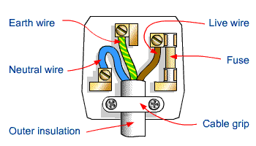
P2 – Physics – The Three-Pin Plug
Earth Wire
Live Wire
Fuse
Neutral Wire
Cable Grip
Insulation

Slide 81
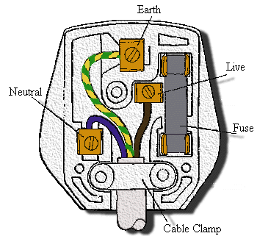
P2 – Physics – The Three-Pin Plug
The neutral wire of a plug stays at a potential close to zero with respect to the earth
The live wire of a plug alternates between positive and negative potential with respect to the neutral wire

Slide 82
P2 – Physics - Safety
If an electrical fault causes too great a current the circuit should be switched off by a fuse or a circuit breaker
When the current in a fuse wire exceeds the rating of the fuse it will melt, breaking the circuit
Appliances with metal cases are usually earthed
The earth wire and fuse together protect the appliance and the user

Slide 83
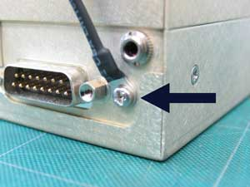
P2 – Physics - Earth wires
Earth wires are always used if an appliance has a _____ case. If there is a _____ in the appliance, causing the live wire to ______ the case, the current “_______” down the earth wire and the ______ blows.
Words – fuse, fault, metal, surges, touch

Slide 84
P2 – Physics - Fuses
Fuses are _______ devices. If there is a fault in an appliance which causes the ____ and neutral (or earth) wire to cross then a ______ current will flow through the _____ and cause it to _____. This will break the _______ and protect the appliance and user from further _____.
Words – large, harm, safety, melt, live, circuit, fuse

Slide 85
P2 - Physics
Power of Electrical Appliances

Slide 86
P2 – Physics - Aims
to calculate the current through an appliance from its power and the potential difference of the supply and from this determine the size of the fuse needed

Slide 87
P2 – Physics – Electrical Appliances
Electrical appliances transform energy
The power of an electrical appliance is the rate at which it transforms energy
Most appliances have their power and the potential difference of the supply they need printed on them
From this we calculate their current and the fuse they need
Electric current is the rate of flow of charge
When an electrical charge flows through a resistor, electrical energy is transformed into heat energy

Slide 88
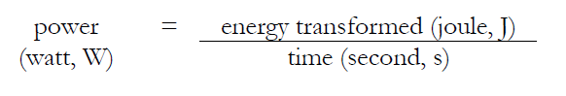
P2 – Physics - Power
The rate at which energy is transformed in a device is called the power
E
P
×
T
i.e. 1 watt = 1 joule per second

Slide 89
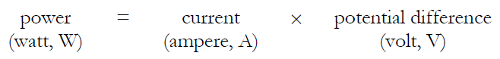
P2 – Physics - Power
Power, potential difference and current are related by the equation:
Using this equation we can work out the fuse rating for any appliance. For example, a 3kW (3000W) fire plugged into a 230V supply would need a current of _______ A, so a _______ amp fuse would be used (fuse values are usually 3, 5 or 13A).
P
V
I

Slide 90
P2 – Physics – What Fuse?!!
Copy and complete the following table:
Appliance | Power rating (W) | Voltage (V) | Current needed (A) | Fuse needed (3, 5 or 13A)
Toaster | 960 | 230
Fire | 2000 | 230
Hairdryer | 300 | 230
Hoover | 1000 | 230
Computer | 100 | 230
Stereo | 80 | 230

Slide 91
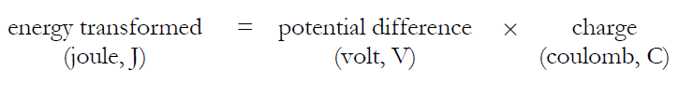
P2 – Physics - Charge
Energy transformed, potential difference and charge are related by the equation:
The amount of energy that flows in a circuit will depend on the amount of charge carried by the electrons and the voltage pushing the charge around:
E
V
Q

Slide 92
P2 – Physics - Charge
In a radio circuit a voltage of 6V is applied and a charge of 100C flows. How much energy has been transferred?
In this circuit the radio drew a current of 0.5A. How long was it on for?
A motor operates at 6V and draws a current of 3A. The motor is used for 5 minutes. Calculate: a) The motor’s resistance, b) the charge flowing through it, c) the energy supplied to it
A lamp is attached to a 12V circuit and a charge of 1200C flows through it. If the lamp is on for 10 minutes calculate a) the current, b) the resistance, c) the energy supplied to the bulb.

Slide 93
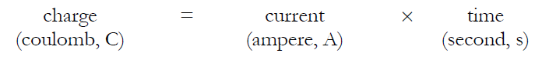
P2 – Physics - Charge
The amount of electrical charge that flows is related to current and time by the equation:
Electricity is when electrons move around a circuit and carry energy with them. Each electron has a negative CHARGE. Charge is measured in Coulombs (C). We can work out how much charge flows in a circuit using the above equation:
Q
I
T

Slide 94
P2 – Physics - Charge
Charge (C) | Current (A) | Time (s)
 | 5 | 2
0.4 | 1
20 | 0.5
50 |  | 250
 | 3 | 60
A circuit is switched on for 30s with a current of 3A. How much charge flowed?
During electrolysis 6A was passed through some copper chloride and a charge of 1200C flowed. How long was the experiment on for?
A bed lamp is switched on for 10 minutes. It works on a current of 0.5A. How much charge flowed?

Slide 95
P2 - Physics
Radiation

Slide 96
P2 – Physics - Aims
(HIGHER TIER ONLY) – to explain how the Rutherford and Marsden scattering experiment led to the ‘plum pudding’ model of the atom being replaced by the nuclear model

Slide 97
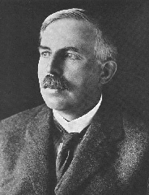
P2 – Physics - Structure of the atom
A hundred years ago people thought that the atom looked like a “plum pudding” – a sphere of positive charge with negatively charged electrons spread through it…
Ernest Rutherford, British scientist:
I did an experiment (with my colleagues Geiger and Marsden) that proved this idea was wrong. I called it the “Scattering Experiment”

Slide 98
P2 – Physics - The Rutherford Scattering Experiment
Alpha particles (positive charge, part of helium atom)
Thin gold foil
Most particles passed through, 1/8000 were deflected by more than 90⁰
Conclusion – the atom is made up of a small, positively charged nucleus surrounded by electrons orbiting in a “cloud”.

Slide 99
P2 – Physics - The structure of the atom
ELECTRON – negative, mass nearly nothing
PROTON – positive, same mass as neutron (“1”)
NEUTRON – neutral, same mass as proton (“1”)

Slide 100
P2 – Physics - The structure of the atom
Particle | Relative Mass | Relative Charge
Proton | 1 | +1
Neutron | 1 | 0
Electron | 0 | -1
MASS NUMBER = number of protons + number of neutrons
4
He
SYMBOL
2
PROTON NUMBER = number of protons

Slide 101
P2 – Physics - Radiation
In an atom the number of electrons is equal to the number of protons in the nucleus. The atom has no net electrical charge
All atoms of a particular element have the same number of protons
Atoms of different elements have different numbers of protons
Atoms of the same element that have different numbers of neutrons are called isotopes

Slide 102
P2 – Physics - Isotopes
An isotope is an atom with a different number of neutrons:
Notice that the mass number is different. How many neutrons does each isotope have?
16
17
18
O
O
O
8
8
8
Each isotope has 8 protons – if it didn’t then it just wouldn’t be oxygen any more.
A “radioisotope” is simply an isotope that is radioactive – e.g. carbon 14, which is used in carbon dating.

Slide 103
P2 – Physics - Background Radiation
13% are man-made
Radon gas
Food
Cosmic rays
Gamma rays
Medical
Nuclear power

Slide 104
P2 – Physics - Types of radiation
1) Alpha (α) – an atom decays into a new atom and emits an alpha particle (2 protons and 2 ______ – the nucleus of a ______ atom)
Unstable nucleus
New nucleus
Alpha particle
2) Beta (β) – an atom decays into a new atom by changing a neutron into a _______ and electron. The fast moving, high energy electron is called a _____ particle.
Beta particle
Unstable nucleus
New nucleus
3) Gamma – after α or β decay surplus ______ is sometimes emitted. This is called gamma radiation and has a very high ______ with short wavelength. The atom is not changed.
Words – frequency, proton, energy, neutrons, helium, beta
Unstable nucleus
New nucleus
Gamma radiation

Slide 105
P2 - Physics
Nuclear Fusion & Fission

Slide 106
P2 – Physics - Aims
to sketch a labelled diagram to illustrate how a chain reaction may occur

Slide 107
P2 – Physics – Nuclear Fission
Nuclear fission is the splitting of atomic nuclei and is used in nuclear reactors as a source of heat energy which can be transformed into electrical energy
There are two fissionable substances in common use in nuclear reactors:
Uranium 235
Plutonium 239
For fission to occur the Uranium 235/Plutonium 239 nucleus must first absorb a neutron
The nucleus undergoing fission splits into 2 smaller nuclei and 2/3 neutrons and energy is released
The neutrons may go on to start a chain reaction

Slide 108
P2 – Physics - Nuclear fission
More neutrons
Neutron
Unstable nucleus
Uranium or plutonium nucleus
New nuclei (e.g. barium and krypton)

Slide 109
P2 – Physics - Nuclear Fission - Chain reactions
Each fission reaction releases neutrons that are used in further reactions.

Slide 110
P2 – Physics – Nuclear Fusion
Nuclear fusion is the joining of two atomic nuclei to form a larger one
Nuclear fusion is the process by which energy is released in stars

Slide 111
P2 – Physics - Nuclear Fusion in stars
Proton
Neutron

